Slide 1


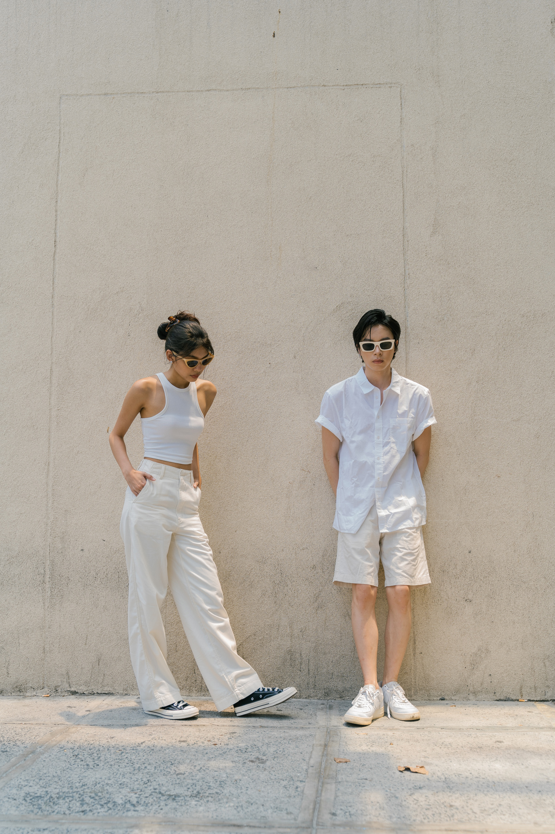

SQL
CaseStudy
Texture Tales
Fashion vs. Style Fashion vs. Style Fashion vs. Style
Presented By : Nikhil Kumar Roy

Slide 2
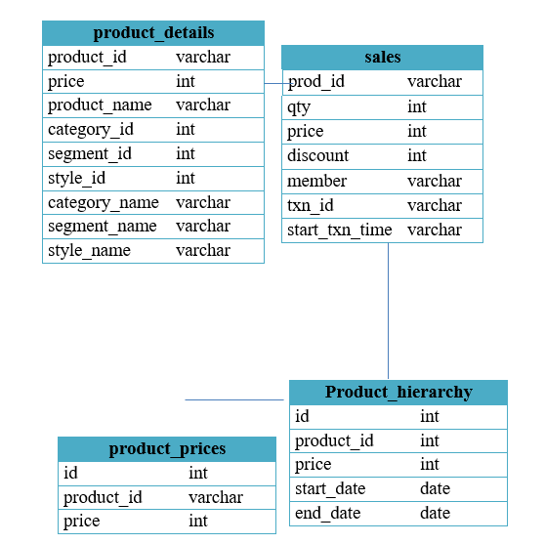
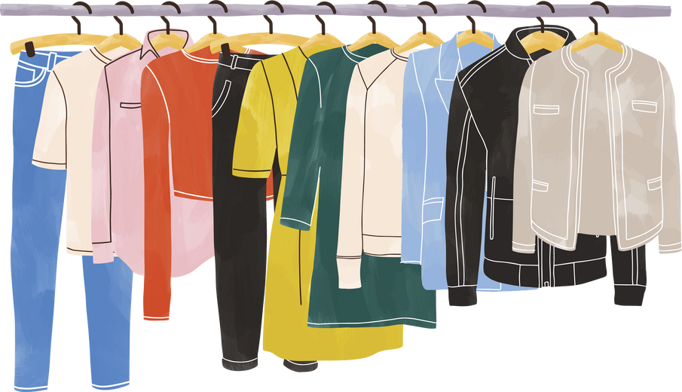

SCHEMA :
INTRODUCTION:
Texture Tales Clothing Company prides themselves on providing an optimized range of clothing and lifestyle wear for the modern adventurer!
I, the CEO of this trendy fashion company is asking you to assist the team’s merchandising teams analyze their sales performance and generate a basic financial report to share with the wider business.

Slide 3

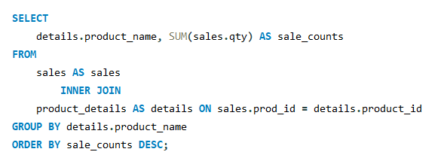
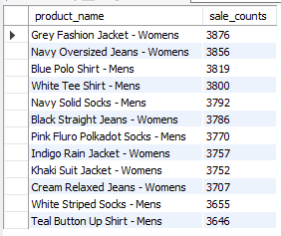
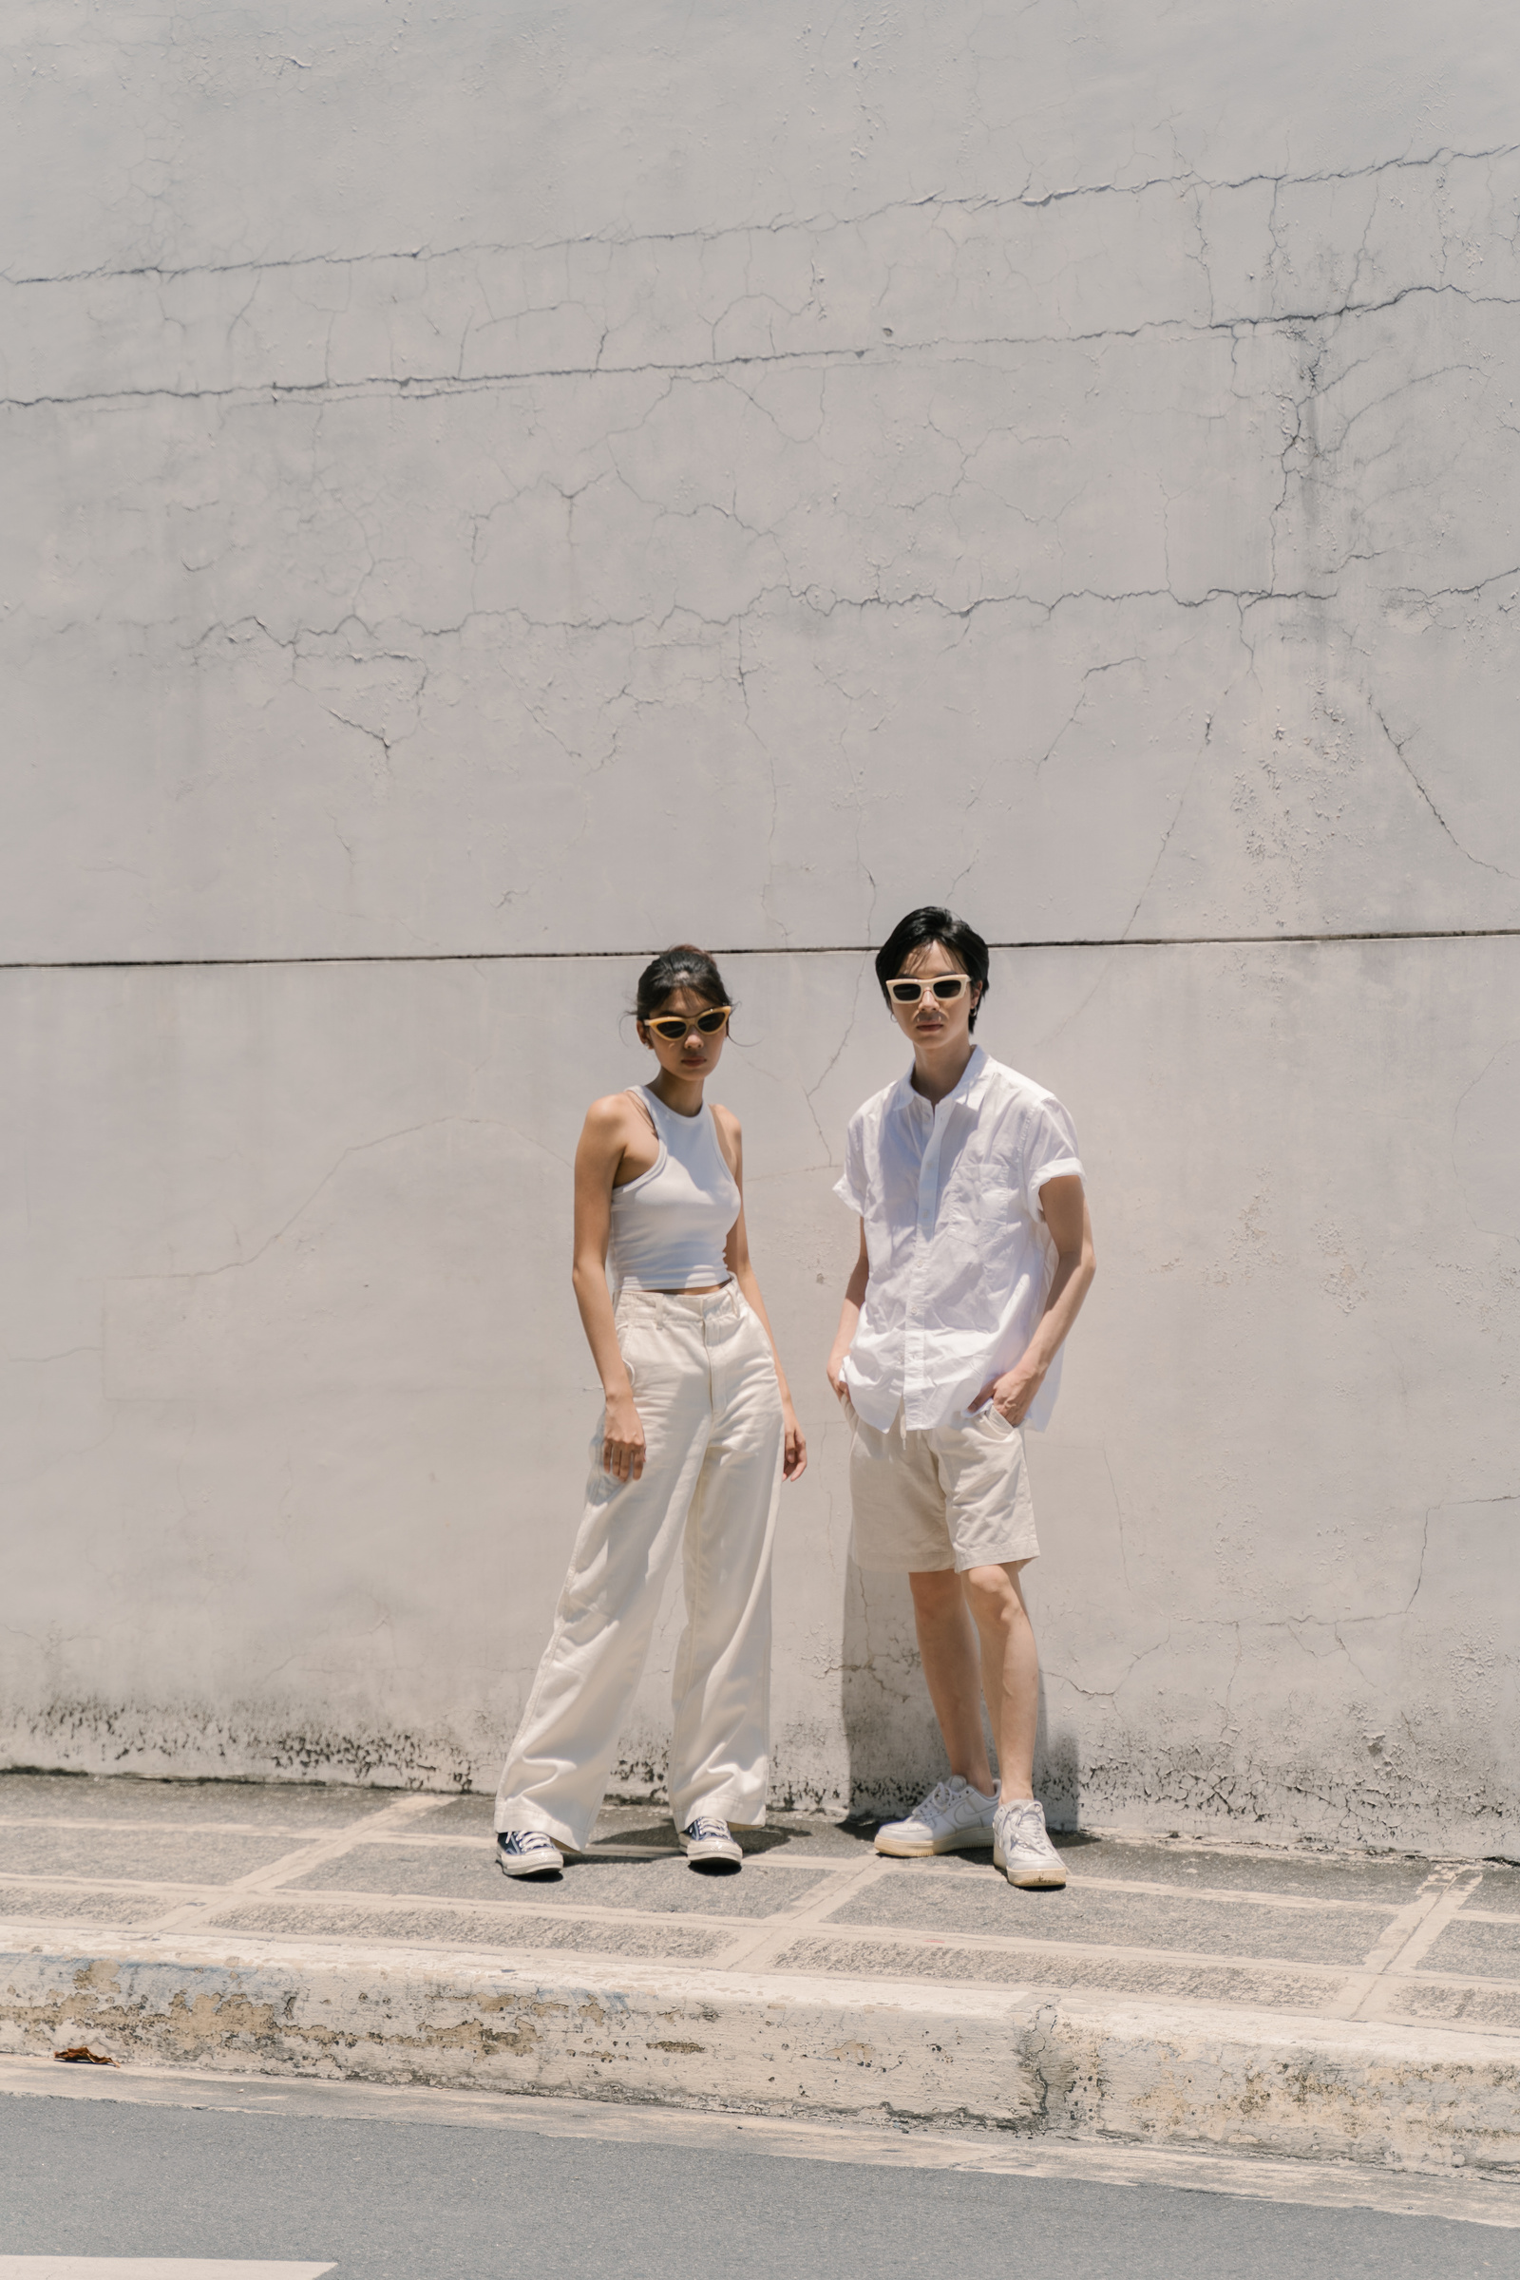
Q1. What was the total quantity sold for all products?

Slide 4
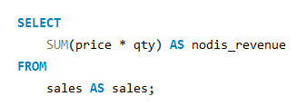

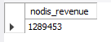
Q2. What is the total generated revenue for all products before discounts?

Slide 5
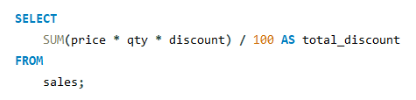

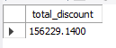
Q3. What was the total discount amount for all products?

Slide 6

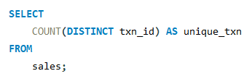
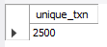

Q4. How many unique transactions were there?

Slide 7
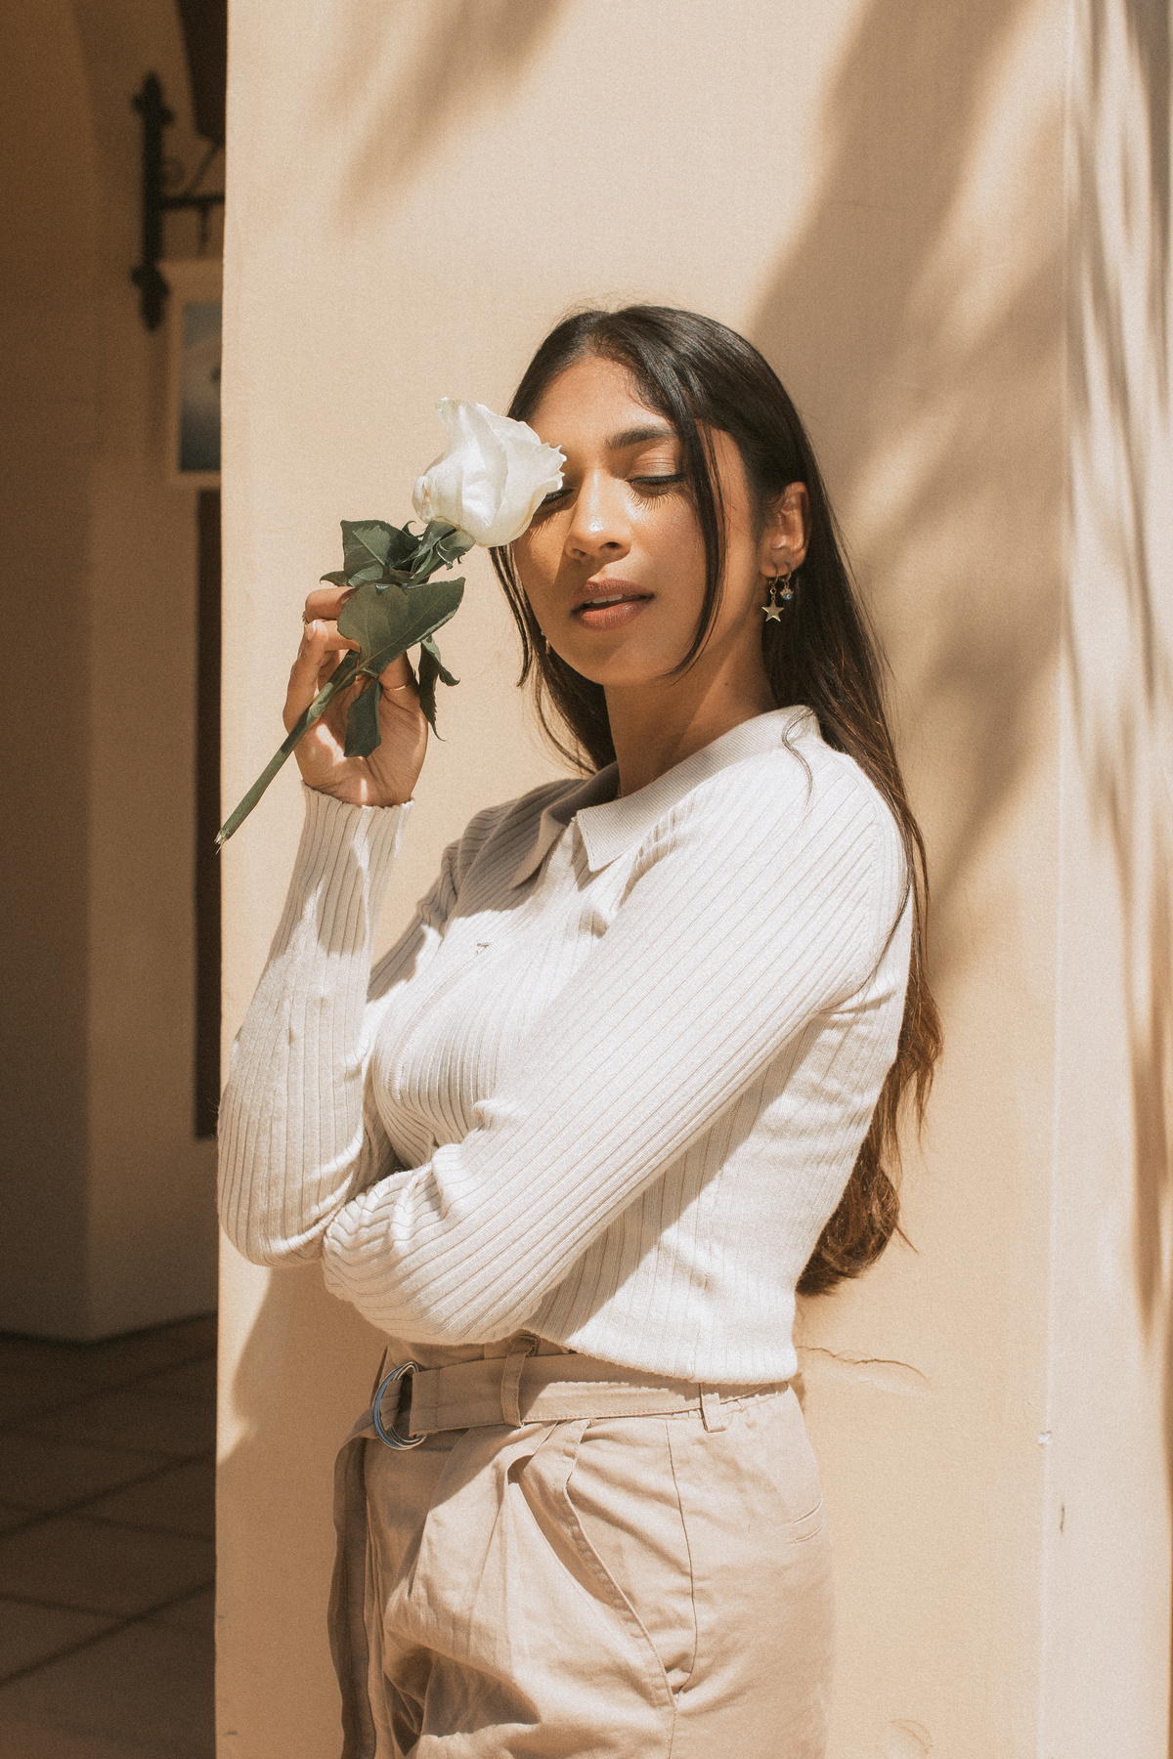
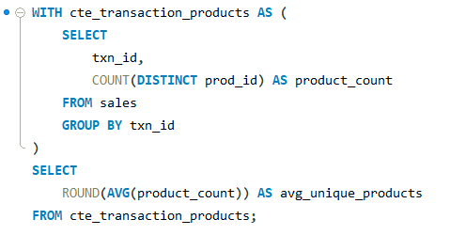
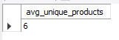
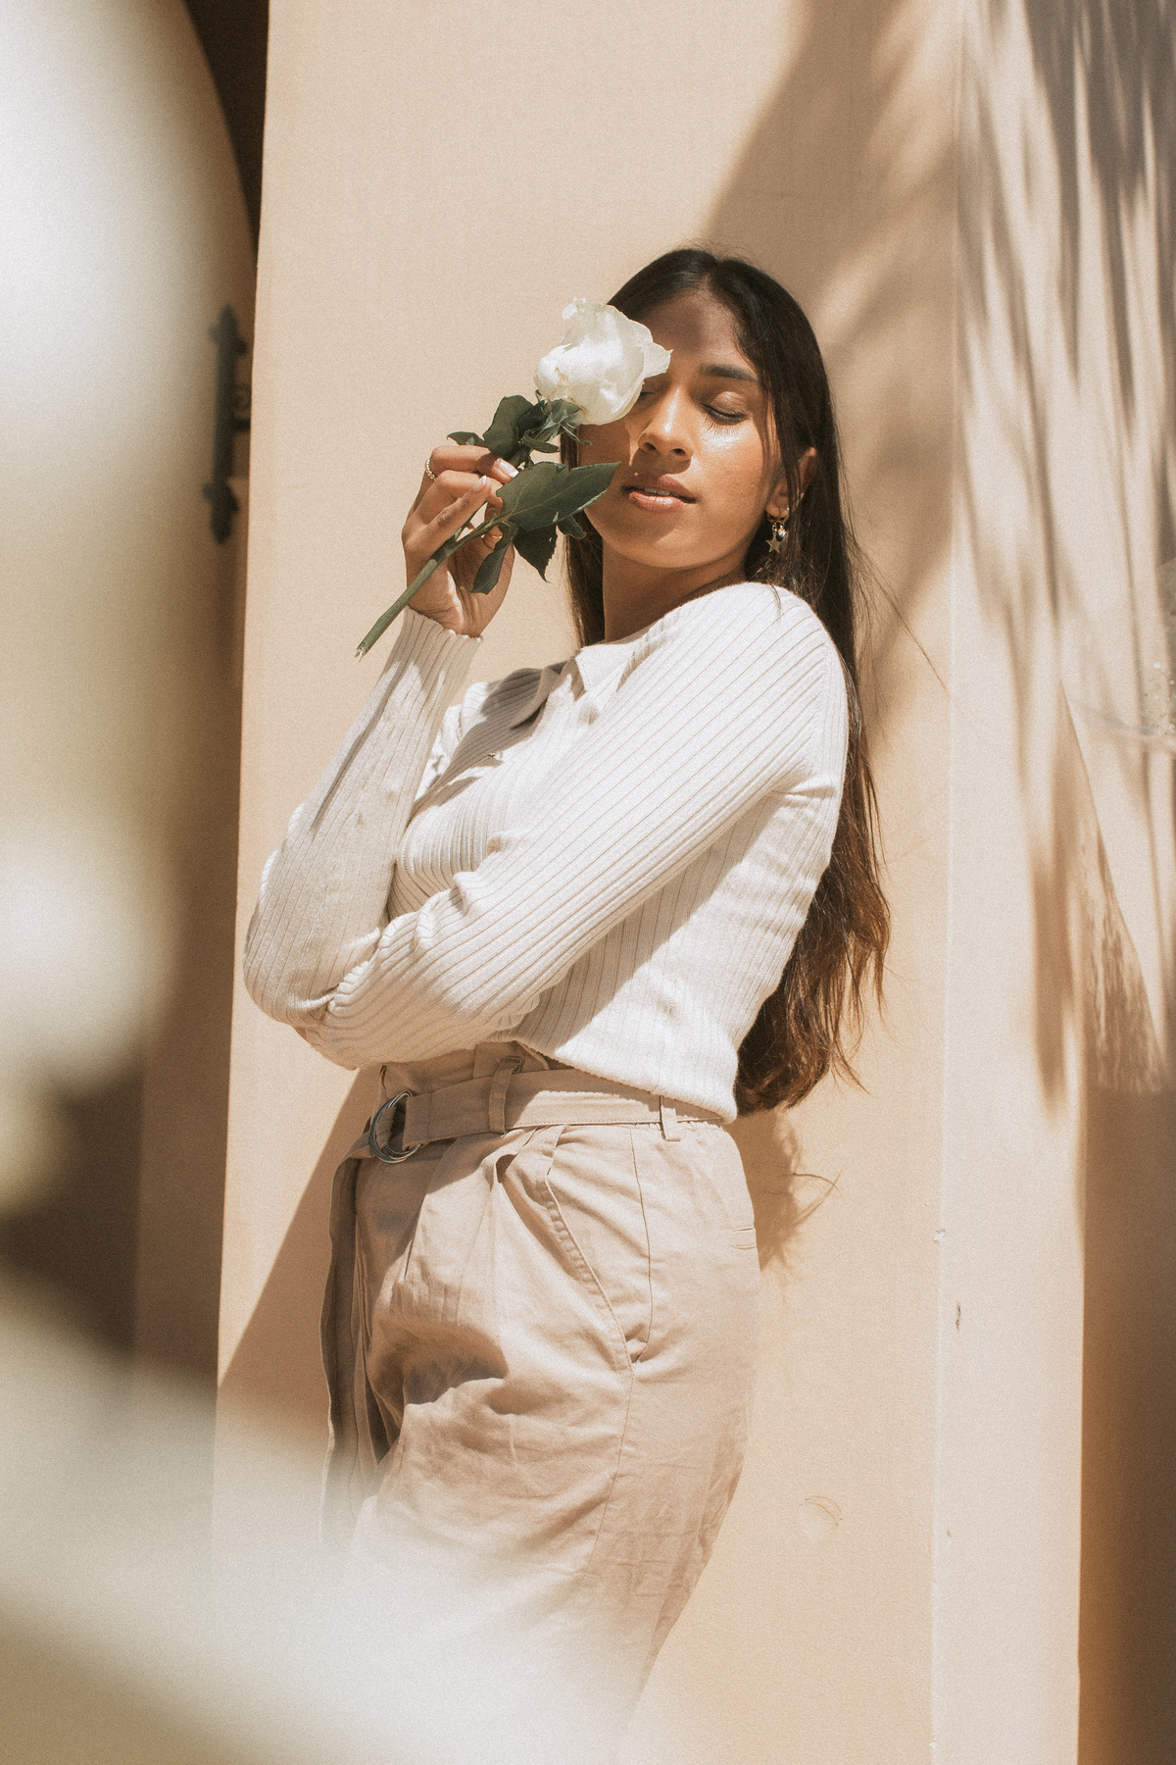
Q5. What are the average unique products purchased in each transaction?

Slide 8

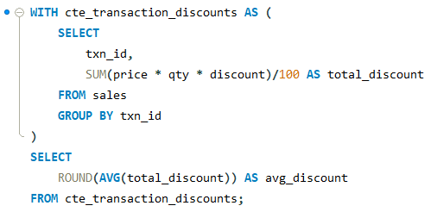
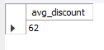
Fashion vs. Style Fashion vs. Style Fashion vs. Style
Q6. What is the average discount value per transaction?

Slide 9
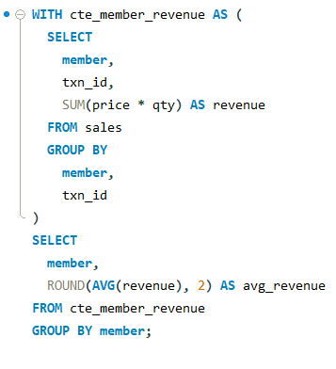
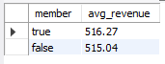
Q7. What is the average revenue for member transactions and non-member transactions?

Slide 10

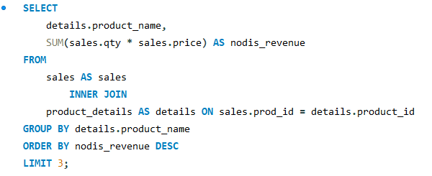
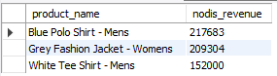
Q8. What are the top 3 products by total revenue before discount?

Slide 11
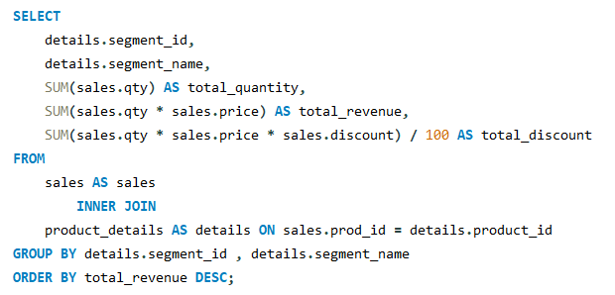
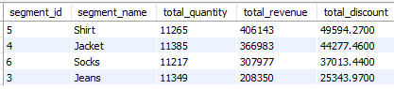

Q9. What are the total quantity, revenue and discount for each segment?

Slide 12
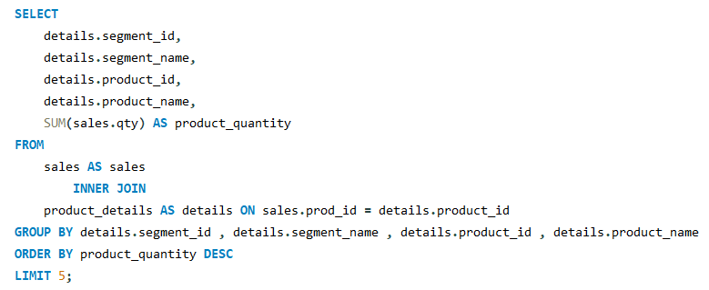
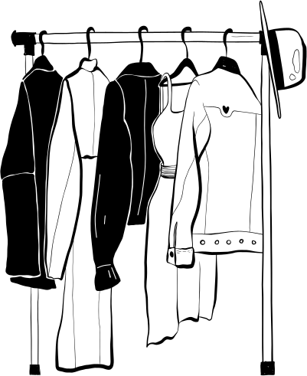
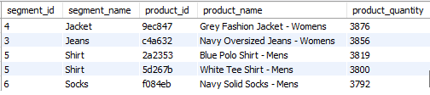
Q10. What is the top selling product for each segment?

Slide 13
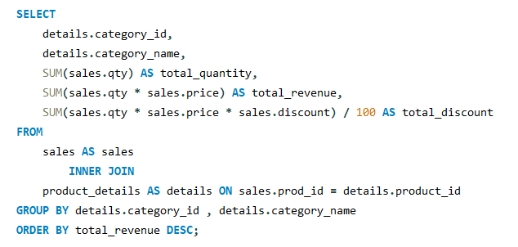
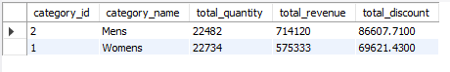
Q11. What are the total quantity, revenue and discount for each category?

Slide 14
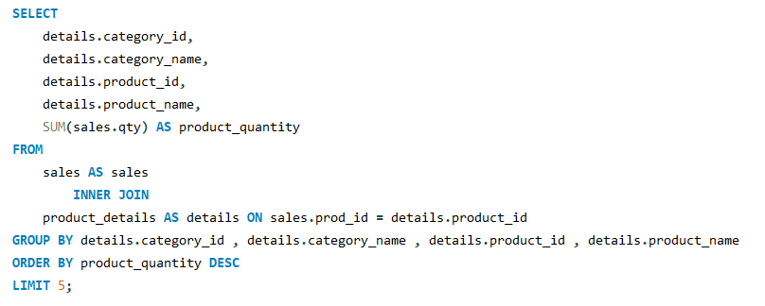
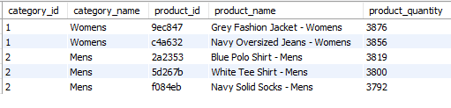
Q12. What is the top selling product for each category?

Slide 15



THANK YOU
Contact me....
https://www.linkedin.com/in/nikhil-kumar-roy/
https://github.com/NikhilRoyDA
nikhilroy744@gmail.com

